Slide 1

Bike Sales Report
Welcome to the world of two wheels!

Slide 2
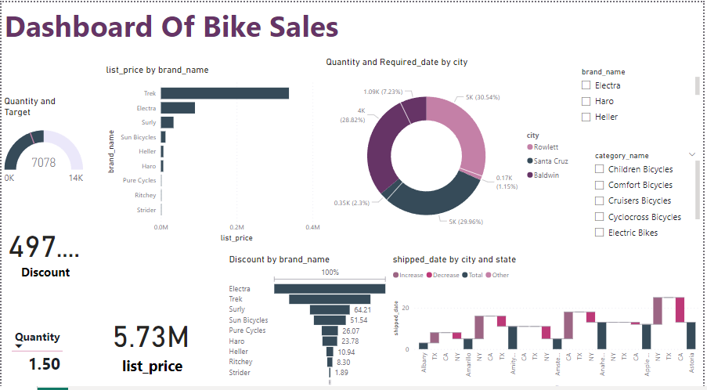
Over All Dashboard Of Bikes

Slide 3
We have achieved our bike sales quantity target of 4000 units. Slide 1: Title slide
Bike Sales Quantity Target
4000 Achieved
We should continue to focus on selling bikes from the top selling brands. We should also offer discounts on bikes to attract more customers.
The donut chart shows the number of bikes sold by each brand.
The funnel chart shows the discount offered on each brand

Slide 4
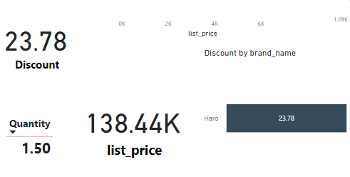
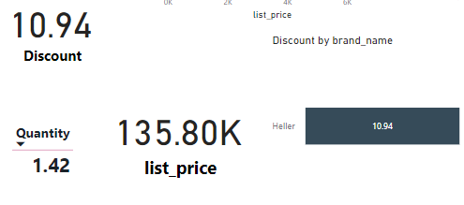
Comparison Of Two Brand
Heller
Haro

Slide 5
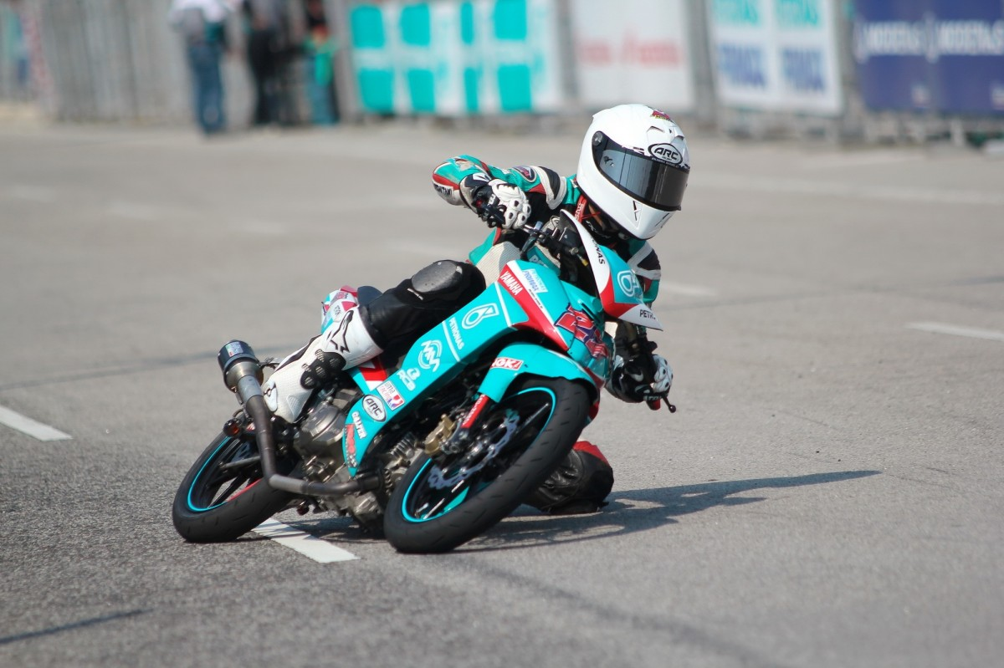
Thank You

